Slide 1
Myntra Analysis
Presented By
Dhivya M- MBE11

Slide 2
Myntra Overview and Business model
Myntra is a leading online fashion retailer in India, specializing in apparel, accessories, and footwear.
Founded in 2007, Myntra's revenue for FY 2022-2023 was approximately ₹2,400 crores (around $290 million), reflecting its strong market presence and customer base.
A customer-centric strategy, collaborations with fashion brands and designers, and investments in state-of-the-art eCommerce technology are all parts of Myntra's business model.
Myntra started its operations in the B2B (Business to Business) segment with the personalization of gifts and then shifted its strategy to become a B2C (Business to Customer) oriented firm.
The product variety of Myntra was enhanced by collaborations with over 6,000 lifestyle and fashion companies, including Levi's, H&M, Biba, Nike, Mango, Hilfiger, and many more.
In 2014, Flipkart made a strategic move by acquiring Myntra for over $300 million.

Slide 3
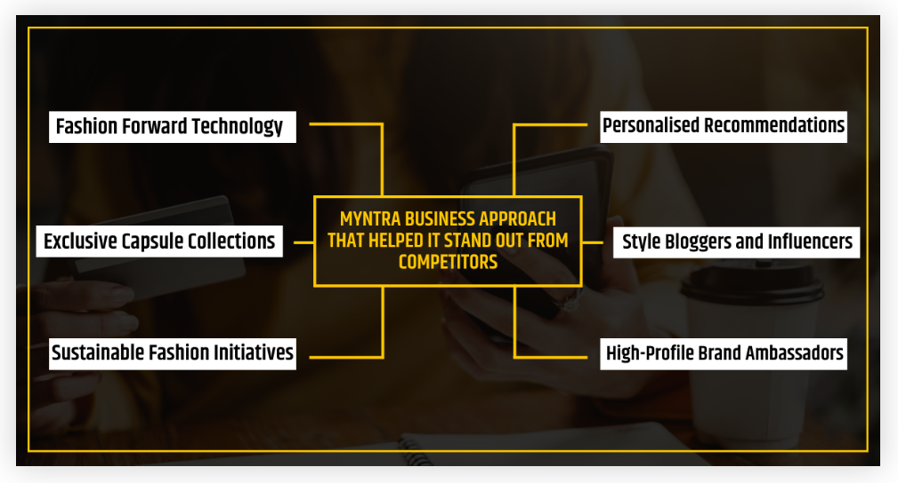
Myntra Business Model Approach that Helped it Stand Out from Competitors
Reference - https://rahulmalodia.com/myntra-business-model/

Slide 4
Brand Perception Analysis
Myntra is perceived as a leading fashion destination in India, particularly among young, style-conscious consumers. Its brand image is shaped by several key factors as follow:
Fashion Forward: Myntra is recognized for its trendy and diverse product offerings, often featuring the latest fashion styles and popular brands. Customers view it as a go-to platform for discovering new trends and unique pieces.
Convenience and User Experience: The brand is appreciated for its user-friendly app and website, making online shopping convenient and enjoyable. Customers value features like personalized recommendations and efficient search options.
Sustainability Initiatives: Increasingly, customers are becoming aware of sustainability in fashion. Myntra's efforts to promote eco-friendly brands and practices are positively noted by environmentally conscious consumers.

Slide 5
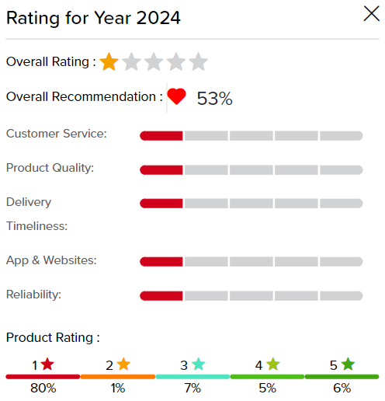
Social Media Engagement: Myntra's active presence on social media helps shape its image as a trendy and relatable brand. Customer engagement through fashion influencers and user-generated content enhances its appeal, especially among younger demographics.
Targeted Audience: Young, tech-savvy people looking for colorful, on-trend clothing at affordable prices make up the bulk of its target demographic, which ranges in age from 18 to 34. From a psychological perspective, their target demographic places a premium on current trends and the ease of internet shopping.
Reference: https://www.mouthshut.com/product-reviews/myntra-reviews-925076140

Slide 6
Customer sentiment Analysis using Social Media Reviews
Myntra, a popular online fashion retailer in India, garners mixed reviews on social media platforms. Overall sentiments reveal strong appreciation for product variety and trends, alongside concerns regarding pricing and customer service.
Positive aspects
Product Range and Variety
Users frequently highlight Myntra's extensive selection of clothing, accessories, and footwear. Many comments express excitement about new collections and trendy styles.
Reviews often include compliments on specific items, such as ethnic wear, casual outfits, and seasonal collections.
Customer reviews - "Amazing collection 😊." "Superb collection. Every piece is awesome 👌."
User Experience
The user-friendly app interface and seamless navigation receive positive mentions. Customers appreciate features like easy filters, wish lists, and the ability to track orders.
Customer reviews - "The app is super easy to navigate! I love how quickly I can find what I’m looking for."

Slide 7
Delivery and Packaging
Prompt delivery and careful packaging are often praised, with users noting that items arrive in good condition and on time.
Customer reviews - "I was pleasantly surprised by how fast my order arrived ❤❤❤. Great job on the delivery!“
Fashion Inspiration
Many users share their styling ideas and outfit combinations sourced from Myntra, showcasing a community that engages in fashion discussions and seeks inspiration.
Customer reviews - "Myntra has an amazing range of styles. I always find something new every time I shop!“
Some of the famous hashtags used to specify Myntra in social media platforms are as follow
#myntra #mymyntralook #myntrafashion #myntraendofreasonsale #myntrafashionupgrade #myntrasale #myntrainsider #myntrabeauty #zoomstyledbymyntra #myntrashopping #motivational_myntra #myntrastudio #staybeautifulwithmyntra #myntrasays #myntrabeautyedit #myntrastyle #myntrahaul #myntraallthingssummer #myntrapricereveal #myntrafashionotsav #myntraeorsislive #myntralook #myntraindia #myntrabigfashiongig #myntrabigfashiondays #myntrablockbustersale

Slide 8
Negative Aspects
Pricing Concerns
A significant number of comments express frustration over high prices. Users often mention that although sales are advertised, the discounts are not substantial enough to make products affordable.
Customer reviews - "Price is too high😮.“"Its Sale but why rates are so expensive."
Product Quality and Sizing Issues
Inconsistent product quality and sizing discrepancies are common complaints. Some users report receiving items that do not match the descriptions or images provided on the site.
Customer reviews - "I received a dress that looked different from what was shown online. Very disappointed."
Customer Service Challenges
Customer service experiences vary, with some users reporting prompt resolutions while others mention delays or unsatisfactory support during issues like returns or refunds.
Customer reviews - "I had a hard time reaching customer support when I needed help with my order. Not impressed 😢."

Slide 9
Return Policy
While Myntra's return policy is generally seen as user-friendly, some reviews point out complications during the return process, such as delays in refunds.
Customer reviews - I don't trust Myntra they are sending us ripped products, and when it comes to refunds, they just find excuses not to give money back
Neutral Aspects
Comments on pricing are mixed. While some users feel that products are fairly priced, others believe that certain items are overpriced, especially compared to similar offerings from competitors. Users often note sales and discounts but express varying opinions on their effectiveness.
Many users acknowledge Myntra's diverse product range, including various brands and styles. While some find the selection appealing, others note that specific sizes or styles may be out of stock.
The app and website are generally described as easy to navigate. Users appreciate features like search filters and personalized recommendations. However, some users mention occasional glitches or slow loading times, which can disrupt the shopping experience.

Slide 10
Current market trends in fashion
The India Fashion Retail Market size was estimated at USD 58.16 billion in 2023
During the forecast period between 2024 and 2030, the India Fashion Retail Market size is projected to grow at a CAGR of 12.65% reaching a value of USD 125.31 billion by 2030.
A prominent driver of the market is increasing disposable incomes, rapid urbanization, and burgeoning middle class.
In the Fashion Market, the number of users is expected to amount to 289.6m users by 2029.
As a melting pot of diverse cultures, India has embraced and adapted Western fashion, leading to a significant transformation in clothing preferences and societal norms.
The trend towards online shopping is expected to continue its upward trajectory, reshaping the retail landscape and setting new benchmarks for customer engagement and satisfaction in the fashion industry.

Slide 11
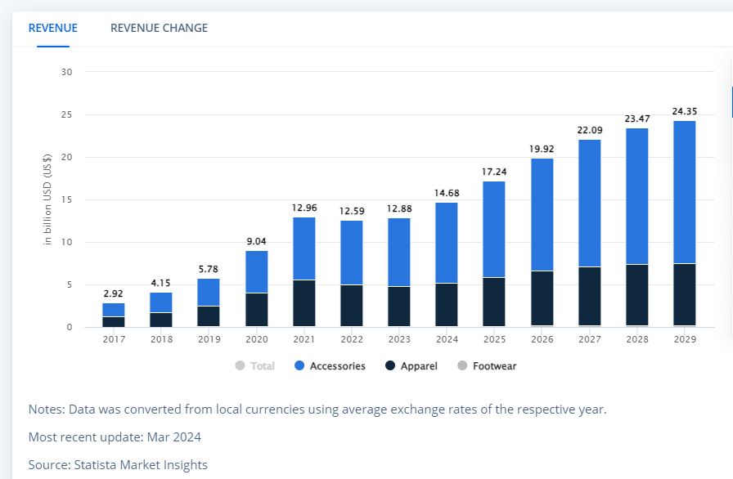
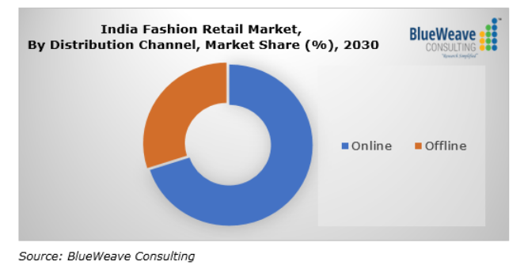

Slide 12
Comparative analysis of Myntra and its competitors.
Here are the top 5 competitors of Myntra –
Flipkart: Flipkart offers a wide range of products including electronics, home goods, fashion, and much more. Even though it is a parent company it competes with Myntra in the fashion space.
Amazon India: It is also a major competitor of Myntra and is instrumental in offering a white range of products like style and fashion items as well.
Ajio: Ajio competes directly with Myntra in the areas of footwear, accessories, and clothing.
Tata Cliq: It is also the leading eCommerce platform offering different types of fashion and lifestyle products and focuses more on luxury and quality brands.
Snapdeal: This is another major competitor of Myntra in India with a broad range of products, lifestyle and fashion products. In terms of pricing and product types, it commits directly to Myntra.

Slide 13
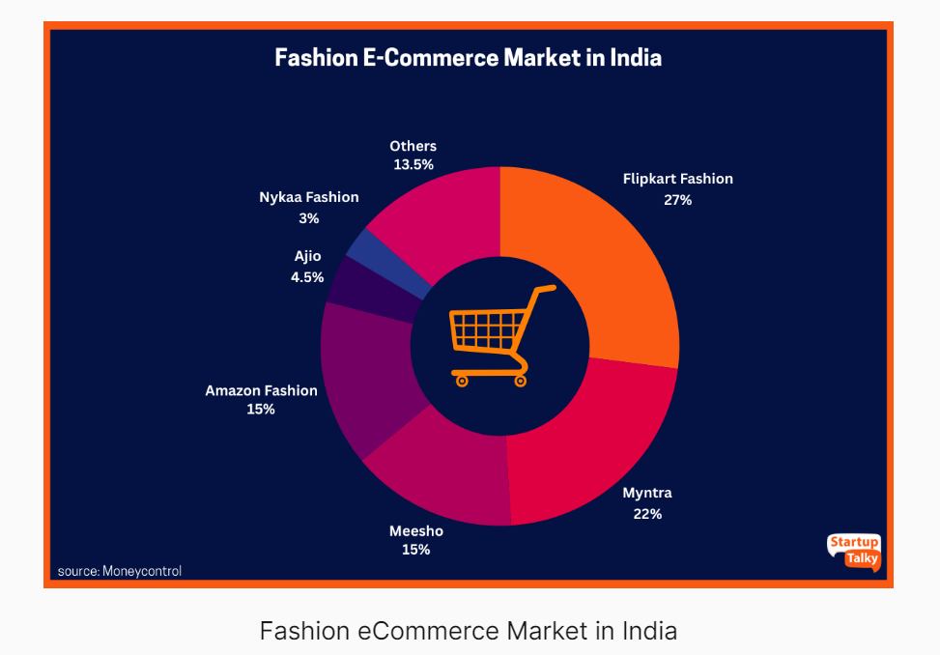
Reference - https://startuptalky.com/myntra-business-model/

Slide 14
Myntra SWOT Analysis
Myntra Strengths
The platform offers a huge product inventory with more than 5,000 brands.
The company's supply network reaches over 90,000 locations nationwide.
Reliable technology and user interfaces enhance the customer experience.
Features include Visual search and Virtual trial rooms powered by augmented reality.
Myntra Weakness
Rival brands such as Jabong, Amazon, Ajio, and Meesho cut into its profits and market share.
Myntra Opportunities
The company stands to gain financially from an increase in private label sales.
The bridal market in India
Myntra should utilize the parent company Flipkart's network to increase exposure and sales.
Myntra Threats
Myntra may face challenges in expanding its consumer base in the face of Amazon's formidable reputation and massive customer base.

Slide 15
Strategic recommendations for improving Myntra’s market position.
Enhance Customer Service Experience
Invest in Customer Support: Implement a more responsive customer service system, including live chat options and a dedicated support team for quick issue resolution.
Streamline Returns and Refunds: Simplify the return process by providing clear instructions, faster processing times, and pre-paid return shipping options.
Focus on Customer Loyalty Programs
Rewards Program: Develop a robust loyalty program that offers rewards for repeat purchases, referrals, and engagement, incentivizing customer retention.
Exclusive Member Benefits: Provide exclusive discounts and early access to sales for loyalty program members to enhance customer loyalty.
Expand Presence in Tier-2 and Tier-3 Cities
Targeted Marketing Initiatives: Tailor marketing efforts to resonate with local cultures and preferences in tier-2 and tier-3 cities.
Local Brand Collaborations: Partner with local brands to offer products that cater specifically to regional tastes and preferences.
Monitor Competitor Strategies
Competitive Intelligence: Regularly analyze competitor offerings, marketing strategies, and customer feedback to stay ahead of industry trends and respond quickly to market changes.

Slide 16
Conclusion
By focusing on enhancing customer service, expanding product offerings, leveraging data analytics, and optimizing marketing efforts, Myntra can strengthen its market position and drive long-term growth.
Adapting to consumer preferences and technological advancements will be key to maintaining relevance in a competitive landscape.

Slide 17
Thank You

